Slide 1
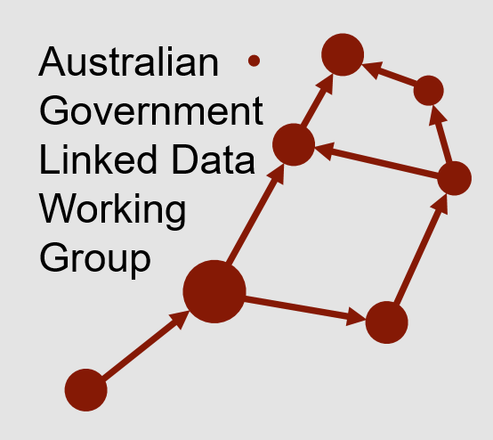

New methods of governing Linked Data
Nicholas Car
Co-Chair AGLDWG, Senior Experimental Scientist, CSIRO
For the Open Data Community Meet-up, 2018-07-20

Slide 2
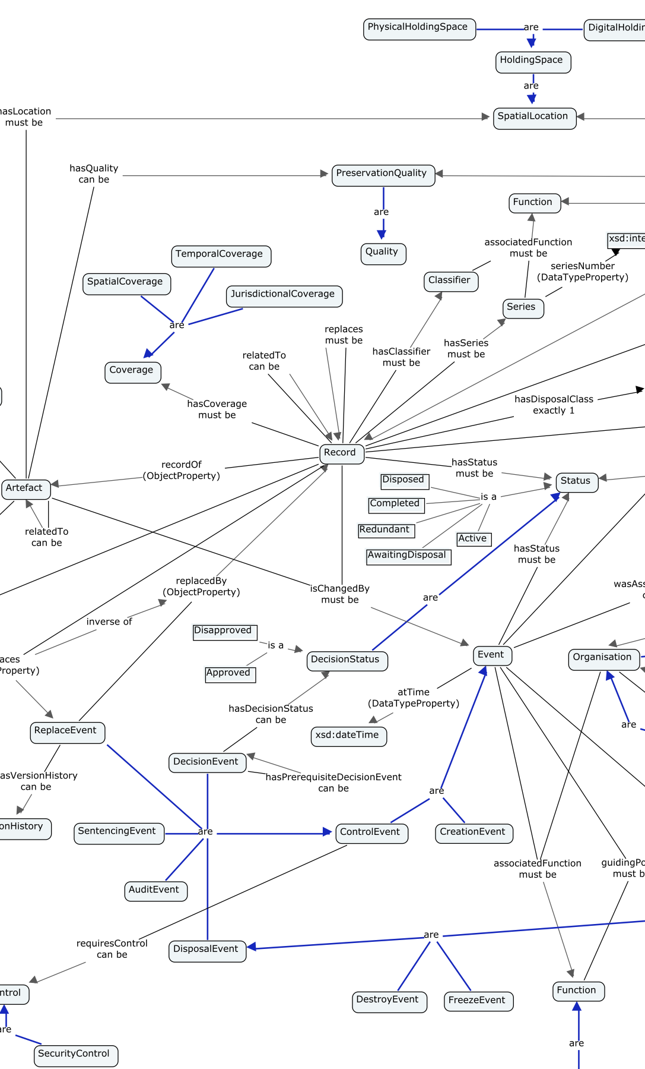
Outline
Defining Linked Data
The Aust Govt Linked Data WG
Things the AGLDWG is doing now
Linked Data catalogue
Aust Govt Integrated Set of Ontologies
Exemplar project – LOC-I

Slide 3
Defining Linked Data
"Linked Data" refers to a set of standards, practices, and tools for publishing and linking structured data on the Web
Data that is Linked Data is linked to other data and can in turn be linked from other data
It is data that is published in a machine-readable way because all data is explicitly described in meaning and in format.

Slide 4
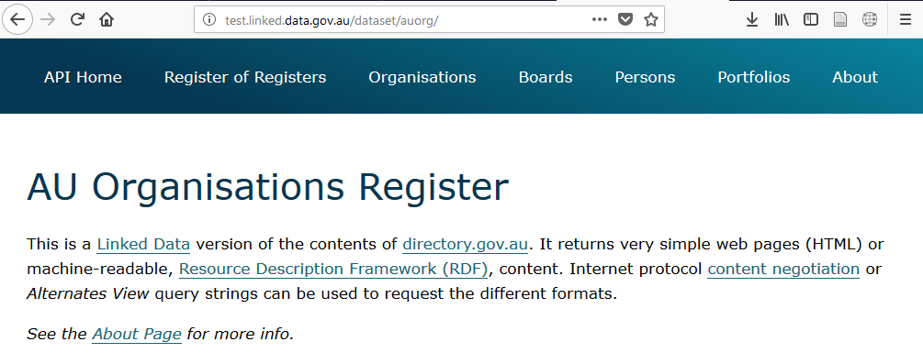
Defining Linked Data
An example Linked Data dataset…

Slide 5
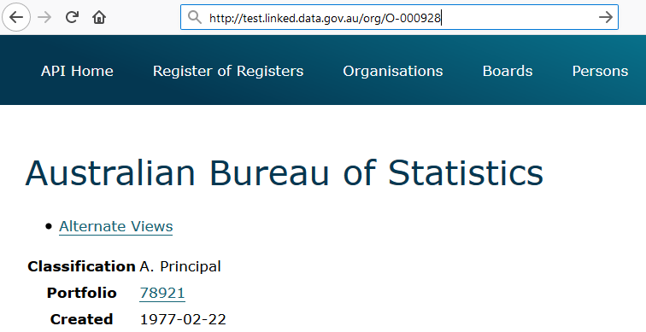
Defining Linked Data
One item in that dataset…

Slide 6
Defining Linked Data
One item in that dataset…
<http://test.linked.data.gov.au/org/O-000928> a org:Organization ;
rdfs:label "Australian Bureau of Statistics" ;
auorg:averageStaffingLevel 2387 ;
auorg:budgetAppropriations "368919000"^^auorg:AustralianDollars ;
auorg:portfolio <http://test.linked.data.gov.au/portfolio/78921> ;
dct:created "1977-02-22"^^xsd:date ;
dct:description "The ABS is..." ;
ns2:hasStreetAddress <http://gnafld.net/address/GAACT714857871> ;

Slide 7
Defining Linked Data
One item in that dataset…
<http://test.linked.data.gov.au/org/O-000928> a org:Organization ;
rdfs:label "Australian Bureau of Statistics" ;
auorg:averageStaffingLevel 2387 ;
auorg:budgetAppropriations "368919000"^^auorg:AustralianDollars ;
auorg:portfolio <http://test.linked.data.gov.au/portfolio/78921> ;
dct:created "1977-02-22"^^xsd:date ;
dct:description "The ABS is..." ;
ns2:hasStreetAddress <http://gnafld.net/address/GAACT714857871> ;

Slide 8
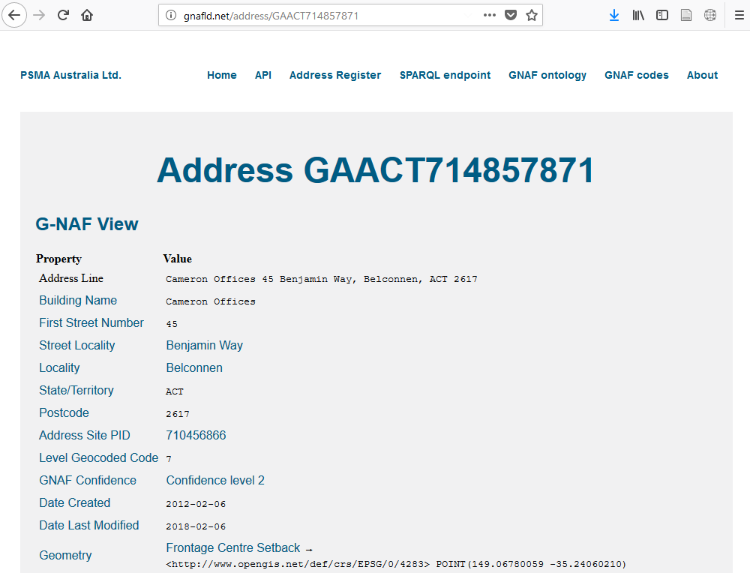
Defining Linked Data
Following that link…
<http://test.linked.data.gov.au/org/O-000928> a org:Organization ;
rdfs:label "Australian Bureau of Statistics" ;
auorg:averageStaffingLevel 2387 ;
auorg:budgetAppropriations "368919000"^^auorg:AustralianDollars ;
auorg:portfolio <http://test.linked.data.gov.au/portfolio/78921> ;
dct:created "1977-02-22"^^xsd:date ;
dct:description "The ABS is..." ;
ns2:hasStreetAddress <http://gnafld.net/address/GAACT714857871> ;

Slide 9
Defining Linked Data
And the result in machine-readable form…
<http://gnafld.net/address/GAACT714857871> a gnaf:Address ;
gnaf:hasBuildingName "Cameron Offices"^^xsd:string ;
gnaf:hasGnafConfidence <gnaf/GnafConfidence_2> ;
gnaf:hasLocality <http://gnafld.net/locality/ACT559> ;
gnaf:hasNumber [ a gnaf:Number ;
gnaf:gnafType <gnaf#FirstStreet> ;
prov:value 45 ] ;
gnaf:hasPostcode 2617 ;
gnaf:hasState <http://www.geonames.org/2177478> ;
gnaf:hasStreet <http://gnafld.net/streetLocality/ACT3134> ;
geo:hasGeometry [ a gnaf:Geocode ;
rdfs:label "Frontage Centre Setback"^^xsd:string ;
gnaf:gnafType <GeocodeTypes#FrontageCentreSetback> ;
geo:asWKT "<EPSG/4283> POINT(149.06780059 -35.24060210)] .

Slide 10














Australian Government Linked Data WG
Community of Commonwealth Government experts and champions, with invited non-voting participation of individuals, corporations and other entities.
Established in August 2012, with strong growth in membership since the Government released the outcomes of an inquiry on Data Availability and Use in the Australian Government
Works as a community of practice that promoting the use of Linked Data technologies for the betterment of Australian Government data sharing.
Manages the domain linked.data.gov.au on behalf of government for use by Linked Data resources

Slide 11
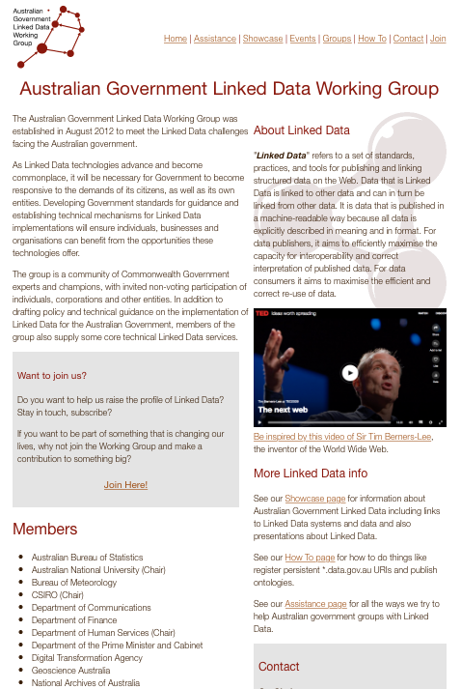
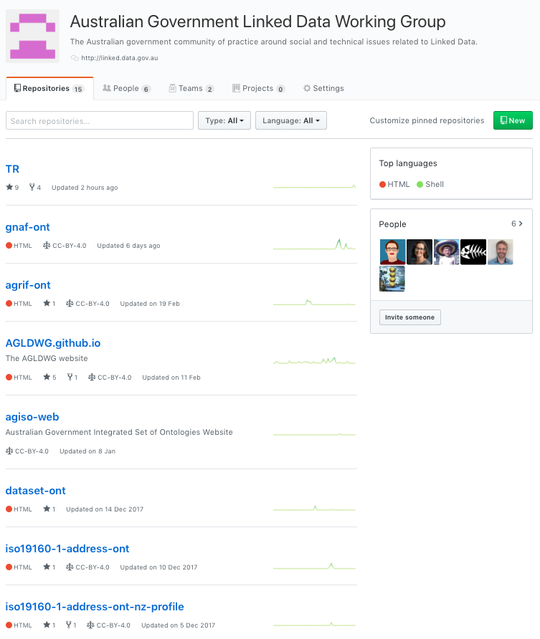
AGLDWG Web Presence
http://linked.data.gov.au
https://github.com/AGLDWG

Slide 12
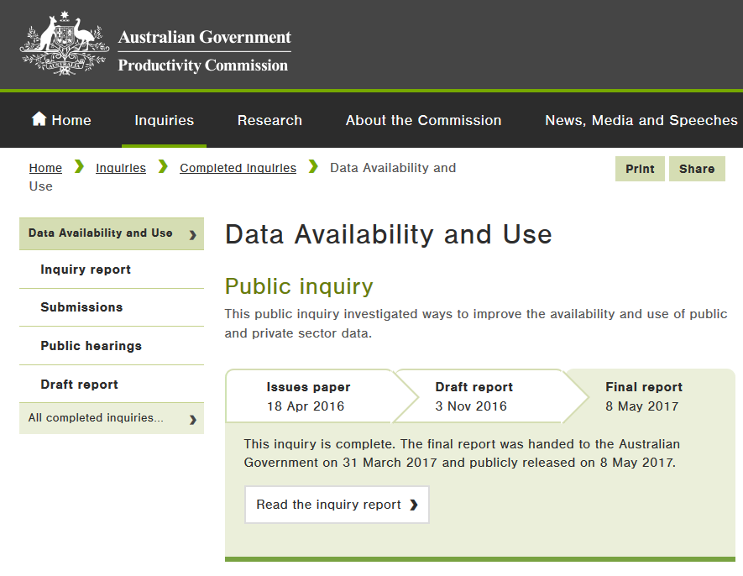
Things the AGLDWG is doing now
Engaging with WoG data initiatives - DAU
Managing the linked.data.gov.au namespace
Establishing a LD resource catalogue
Moving towards an integrated set of ontologies

Slide 13
Managing linked.data.gov.au
The WG is establishing a new URI allocation mechanism that:
Stable for the long-term

Slide 14
Managing linked.data.gov.au
The WG is establishing a new URI allocation mechanism that:
Stable for the long-term
An MoU is the start of that
Likely more formal agreements to come

Slide 15
Managing linked.data.gov.au
The WG is establishing a new URI allocation mechanism that:
Stable for the long-term
Gives persistent identity and resolution to web resources
Gives addresses for whole datasets and individual elements

Slide 16
Managing linked.data.gov.au
The WG is establishing a new URI allocation mechanism that:
Stable for the long-term
Gives persistent identity and resolution to web resources
Gives addresses for whole datasets and individual elements
http://test.linked.data.gov.au/dataset/auorg - AU Org dataset
http://test.linked.data.gov.au/org/O-000928 - ABS within AU Org

Slide 17
Managing linked.data.gov.au
The WG is establishing a new URI allocation mechanism that:
Stable for the long-term
Gives persistent identity and resolution to web resources
Gives addresses for whole datasets and individual elements:
Allows for content negotiation

Slide 18
Managing linked.data.gov.au
The WG is establishing a new URI allocation mechanism that:
Stable for the long-term
Gives persistent identity and resolution to web resources
Gives addresses for whole datasets and individual elements:
Allows for content negotiation
http://test.linked.data.gov.au/org/O-000928 - in HTML & RDF
<http://test.linked.data.gov.au/org/O-000928> a org:Organization ;
rdfs:label "Australian Bureau of Statistics" ;
auorg:averageStaffingLevel 2387 ;
auorg:budgetAppropriations "368919000"^^auorg:AustralianDollars ;
auorg:portfolio <http://test.linked.data.gov.au/portfolio/78921> ;
dct:created "1977-02-22"^^xsd:date ;
dct:description "The ABS is..." ;
ns2:hasStreetAddress <http://gnafld.net/address/GAACT714857871> ;

Slide 19
Linked Data catalogue
The WG is developing a catalogue of Linked Data resources
Datasets
Definitional resources – ontologies (models) & vocabularies

Slide 20
Linked Data catalogue
The WG is developing a catalogue of Linked Data resources
Datasets
Delivered via APIs or as static RDF datasets
LD API
RDF File
Hosted on data.gov.au
G-NAF DB

Slide 21
Linked Data catalogue
The WG is developing a catalogue of Linked Data resources
Datasets
Definitional resources – ontologies (models) & vocabularies
RDF File
HTML File
+
Auto-generated!

Slide 22
Linked Data catalogue
The WG is developing a catalogue of Linked Data resources
Datasets
Definitional resources – ontologies (models) & vocabularies
Registers – lists of defined objects
All the “Organisations” in Australia
Government orgs
Businesses
NGOs

Slide 23
Linked Data catalogue
The WG is developing a catalogue of Linked Data resources
The catalogue itself will be a LD resource!

Slide 24
Moving towards an integrated set of ontologies
Currently, several ontologies developing with a ‘whole of government’ focus
We aim to implement a methodology to integrate multiple ontologies
Allows use as if they were one data model
Allows specialists to manage just their bit

Slide 25
Moving towards an integrated set of ontologies
Currently, several ontologies developing with a ‘whole of government’ focus
We aim to implement a methodology to integrate multiple ontologies

Slide 26
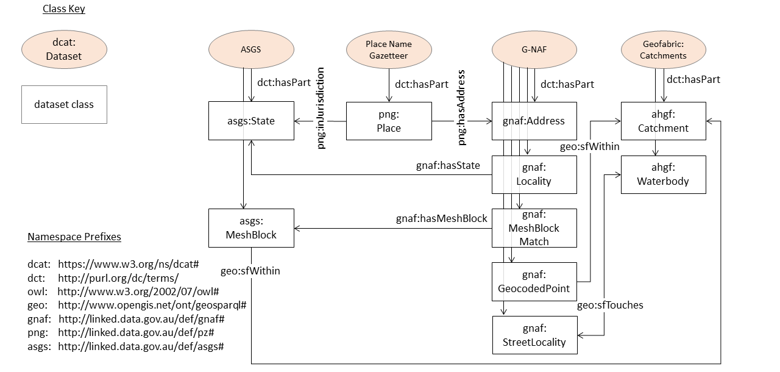
Moving towards an integrated set of ontologies
FSDF-O, a taste of things to come

Slide 27
Moving towards an integrated set of ontologies
Currently, several ontologies developing with a ‘whole of government’ focus
We aim to implement a methodology to integrate multiple ontologies
This is a world first!

Slide 28
Exemplar project – LOC-I
ABS NISA funded
CSIRO, GA, ABS, DoEE, ATO?
Will cross-walk independently-created datasets, integrating on location

Slide 29
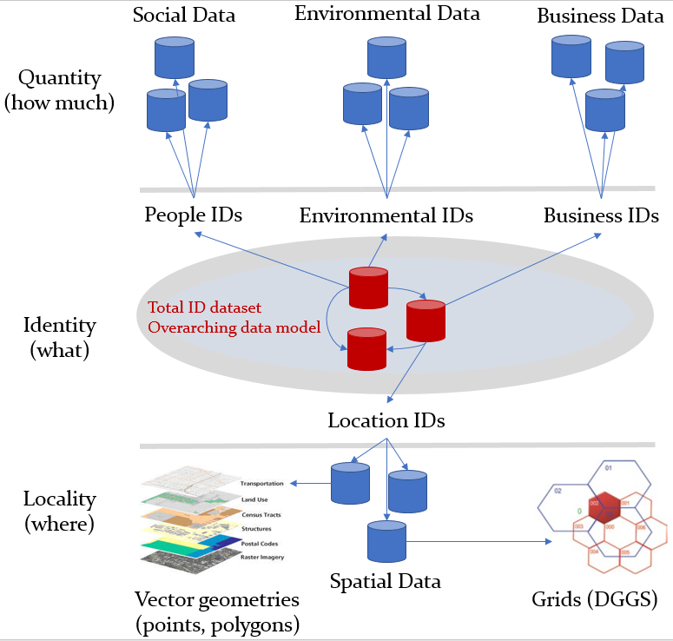
Exemplar project – LOC-I

Slide 30
Join http://linked.data.gov.au/join.html
Contacts
AGLDWG: http://linked.data.gov.au
Nick: nicholas.car@csiro.au

